Slide 1
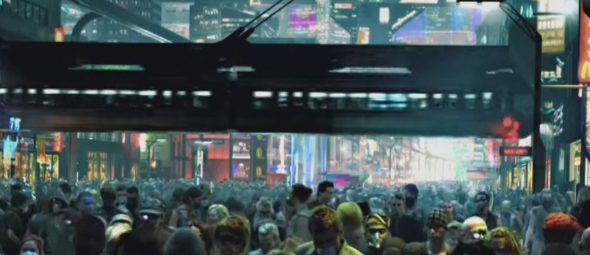
High-Capacity Monorail
- An affordable way of beating the grid-lock on the ground?
The earth in 2154 (Avatar, James Cameron) ….. or Melbourne in ten years?

Slide 2
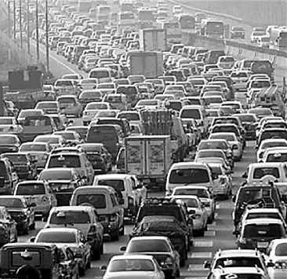
Why Monorail?
Why elevated?
What is a monorail?
Why use a monorail?
Why not use a monorail?
The Switch Myth
Aesthetics
Cost figures

Slide 3
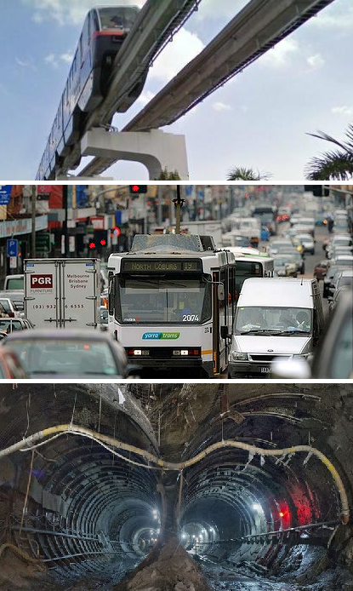
1) Why elevated?
Three places to put a transit system:
Above ground level
At ground level
Below ground level (~$1 Billion / km)
If there is no space at ground level then above ground is quicker, easier and cheaper.

Slide 4
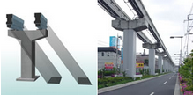
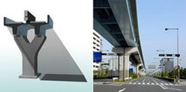
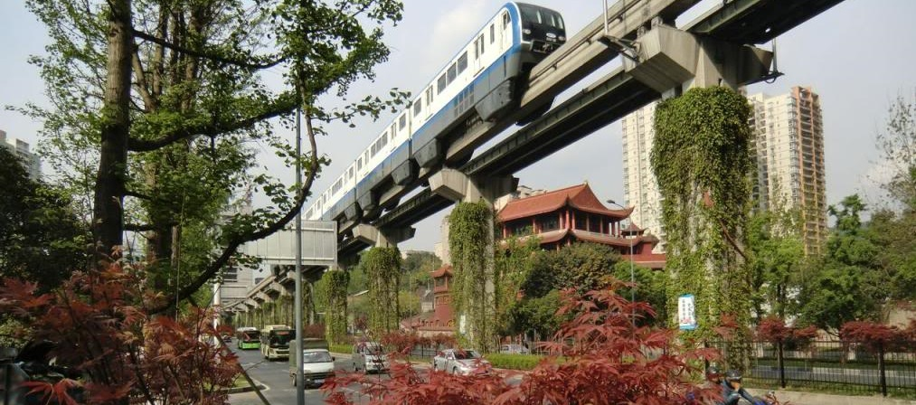
Monorail vs. Other Elevated
Monorail has less visual impact than other high-capacity elevated systems

Slide 5
2) What is a Monorail?
"A single rail serving as a track for passenger or freight vehicles. In most cases rail is elevated, but monorails can also run at grade, below grade or in subway tunnels. Vehicles are either suspended from or straddle a narrow guide way.
Monorail vehicles are wider than the guide way that supports them.”
- Monorail Society

Slide 6
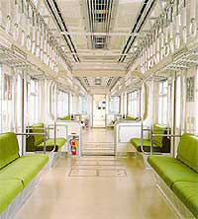
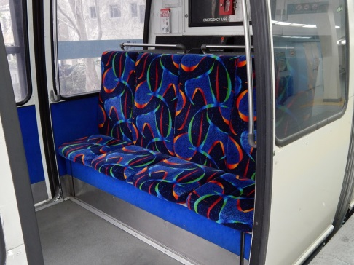
High-capacity vs. tourist monorails
High Capacity Monorails
Flat floor allows passengers to walk-through the train
Two tracks allows travel in both directions
Hundreds of passengers per train
Tourist Monorails
Separate carriages - cannot walk through
Mostly short single-track loops
Under 100 passengers per train
Not suitable for a public-transit systems
(E.g. Former Sydney monorail, Sea World and Broadbeach monorails.)

Slide 7
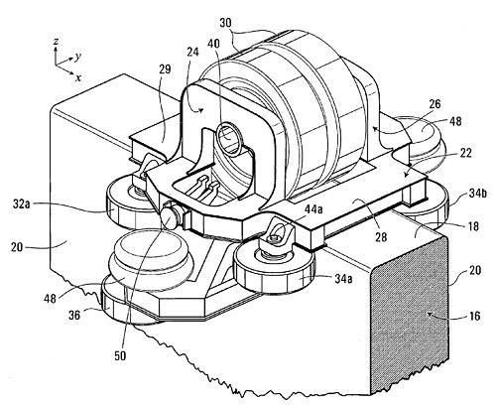
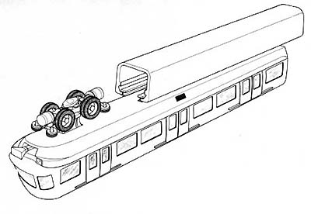
Conventional monorail systems
Rubber tyres on a beam “ALWEG” (left)
Rubber tyres in a beam “SAFEGE” (right)

Slide 8
Straddle beam
The Hitachi straddle beam commuter monorail system in Chongqing is now about 80 km long.

Slide 9
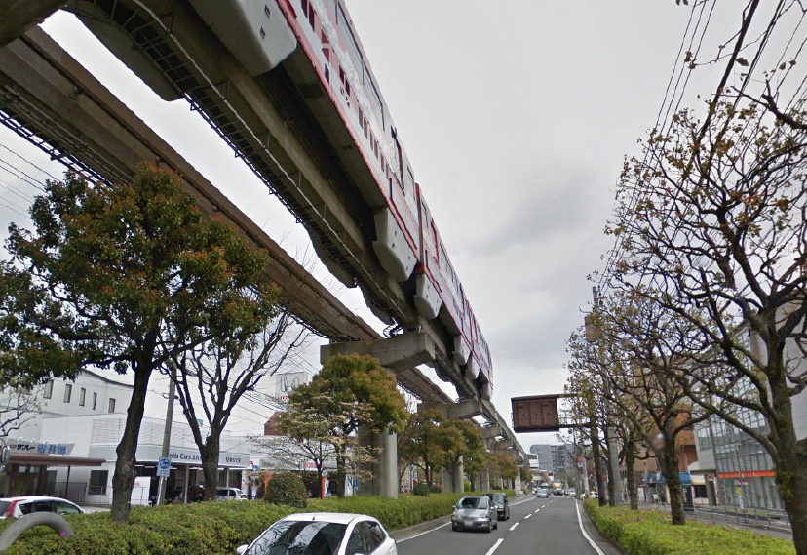
Straddle beam
Another large Hitachi monorail at Kitakyushu, Japan.

Slide 10
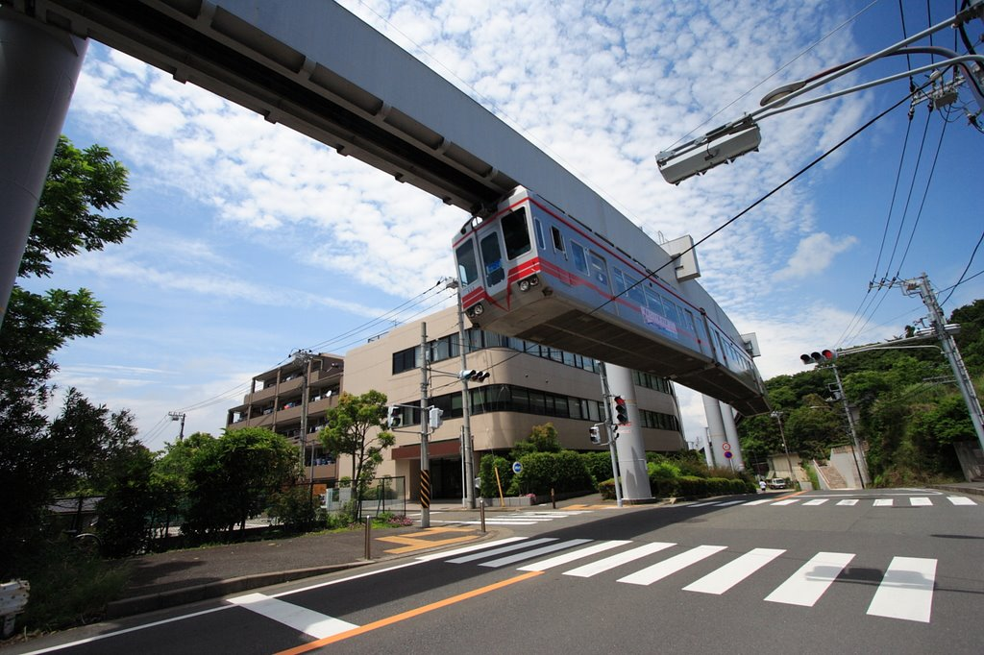
Suspended
Mitsubishi suspended commuter monorail system (Shonan, Japan)

Slide 11
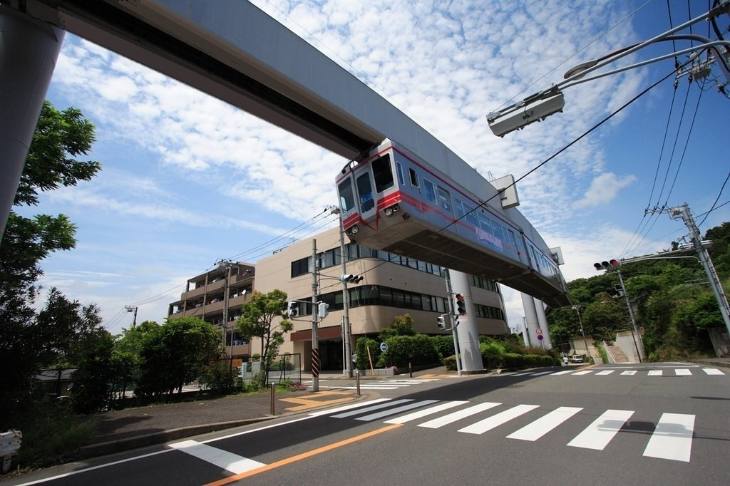
Suspended
Mitsubishi suspended commuter monorail system (Shonan, Japan)
(Edited to show effect of covering the ribbing at the base of the guide-way)

Slide 12
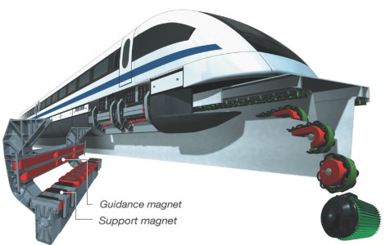
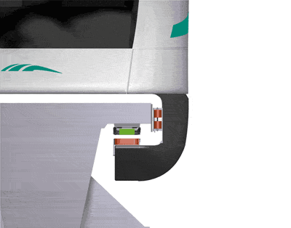
Maglev monorail system
The guide-way is a linear motor. Train floats on a magnetic field and is propelled by the track. Can float for 1 hour on batteries if power lost. (Transrapid)

Slide 13
High-speed monorail system
Transrapid maglev monorail system is recommended for where speeds of between 100 and 500 km/h are needed (Image: Shanghai)

Slide 14
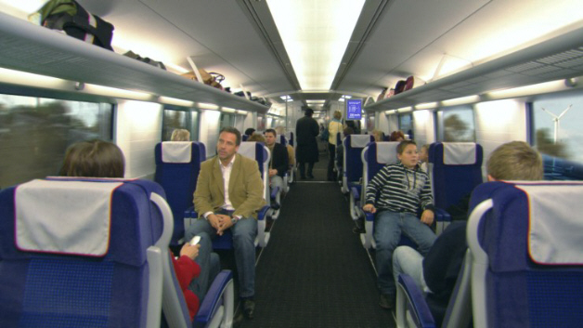
High-speed monorail system
Transrapid maglev have 3.7m wide cars and can have 10-cars to a train.

Slide 15
Trains, Trams & Monorails
100%
X’Trapolis Metro train: ~400 passengers. 72m long x 3m wide.
80%
Hitachi ‘Large’ monorail: ~350 passengers. 59 m long x 3m wide. (Can be 8-cars)
40%
Bombardier E-Class Tram: ~210 passengers. 33m long x 2.7m wide.
128%
3-car Transrapid maglev. 75.8m long x 3.7m wide. (Can be 10-cars)

Slide 16
System | Inception | Type | Length (km) | Patronage / Capacity
Tokyo-Haneda Airport (Hitachi) | 1964 | ALWEG | 17.8 | 120,000 per day
Shonan (Mitsubishi) | 1970 | SAFEGE | 6.6 | 30,000 per day
Kitakyushu, Japan (Hitachi) | 1985 | ALWEG | 8.8 | 31,700 per day
Chiba (Mitsubishi) | 1988 | SAFEGE | 15.5 | 45,000 per day
Osaka, Japan (Hitachi) | 1990 | ALWEG | 28 | 100,000 per day
Tama, Japan (Hitachi) | 1998 | ALWEG | 16 | 92,700 per day
Naha, Okinawa, Japan (Hitachi) | 2003 | ALWEG | 12.8 | 35,000 per day
Kuala Lumpur, Malaysia (Monorail Malaysia) | 2003 | ALWEG | 8.6 | 45,000 per day
Palm Jumeirah, United Arab Emirates(Hitachi) | 2003 | ALWEG | 5.4 | 40,000 per day
Las Vegas Monorail, Nevada (Bombardier) | 2004 | ALWEG | 6.3 | 30,000 per day
Chongqing Monorail (Hitachi) | 2005 | ALWEG | 74.6 | 30,000 per hour
Mumbai, India (Scomi) | 2014 | ALWEG | 20 | 125,000 per day*
São Paulo, Brazil Line 15 (Bombardier) | 2014 | ALWEG | 26 | 48,000 PPHPD*
Daegu, South Korea (Hitachi) | 2015 | ALWEG | 24 | N/A

Slide 17
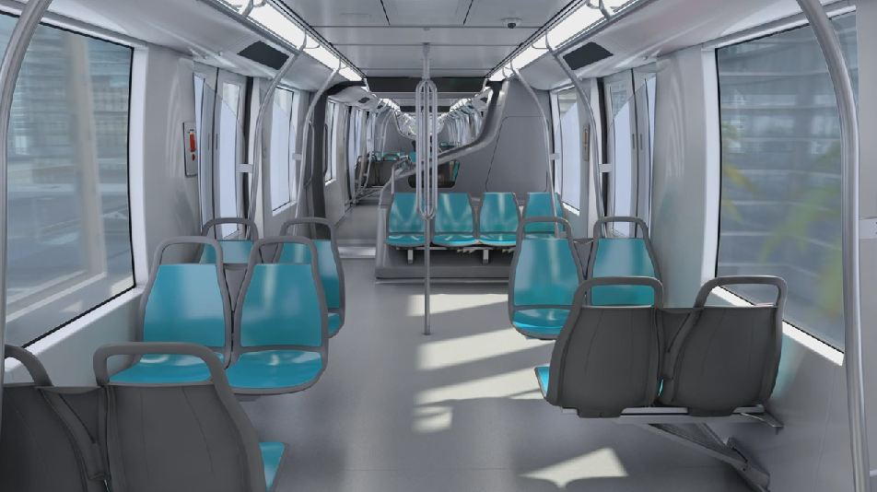
Flat-floor walk-through interiors
A passenger cannot tell that these are monorails from the interior.
(Left – Hitachi, Right – Bombardier)

Slide 18
3) Why use a monorail?
Can be cost effective. Large monorails are usually under 10% of the cost of heavy rail subway systems.
Proven. Many systems are in use carrying millions of passengers per year especially in Japan and China.
Safe. Monorails are fully grade separated. Evacuation from one train to another, to a walkway or to the ground is possible. Monorails do not flood and are not below sea level.
Can be Automated.

Slide 19
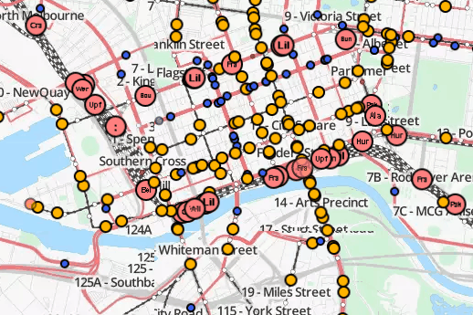
Why consider a monorail?
Independence. No impact on existing transit systems which are already at or near capacity.
Melbourne CBD
Red: Trains
Blue: Busses
Yellow: Trams

Slide 20
4) Why not use a monorail?
You have a free grade-separated easement. No need for a subway or monorail in this situation.
No traffic congestion. If the roads are not busy buses or trams can be used.
Lots of stops. If you need stops every 100 meters then a monorail will be too expensive.
No space above ground. In this case subway is the only option left.

Slide 21
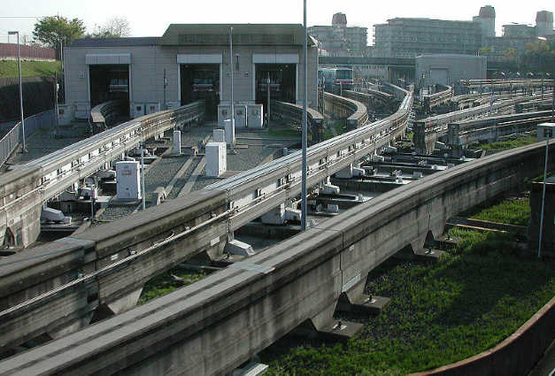
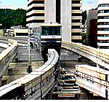
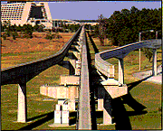
5) The Switch Myth
Switches are a problem. Reality: All serious monorail systems have switches that are operated thousands of times a day.

Slide 22
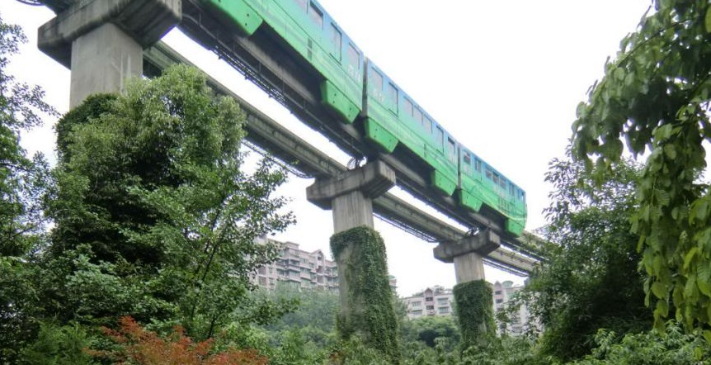
6) Aesthetics
We recommend a sandstone-coloured guide-way and creeper covered pillars.

Slide 23
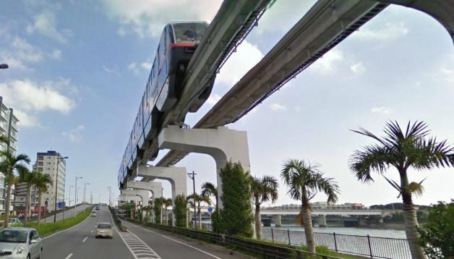
Aesthetics

Slide 24
7) Cost figures
Hitachi 'Medium' and 'Large' monorails
Cairo, Egypt: $US 29 million / km. 52 km. 2015 (Bombardier quote).
Okinawa, Japan: $US 27 million / km. 12.8 km. 1985.
Kitakyushu , Japan: $US 62 million / km. 8.8 km. 1985. (Large type)
Palm Jumeirah, Dubai: $US 73 million / km. 5.4 km. 2006.
Scomi Monorails
Mumbai Monorail: $US 27.25 million/km. 9 km 2008.
Kuala Lumpur: $US 36 million / km. 8.6 km. 2003.
Transrapid Maglev
Shanghai maglev: $US 43 million/km. 30.5 km. 2004.

Slide 25
www.MonorailsAustralia.com.au

